Slide 1

Review of Assessments for ELLs
Lisa Tucker
Okaloosa County School District

Slide 2
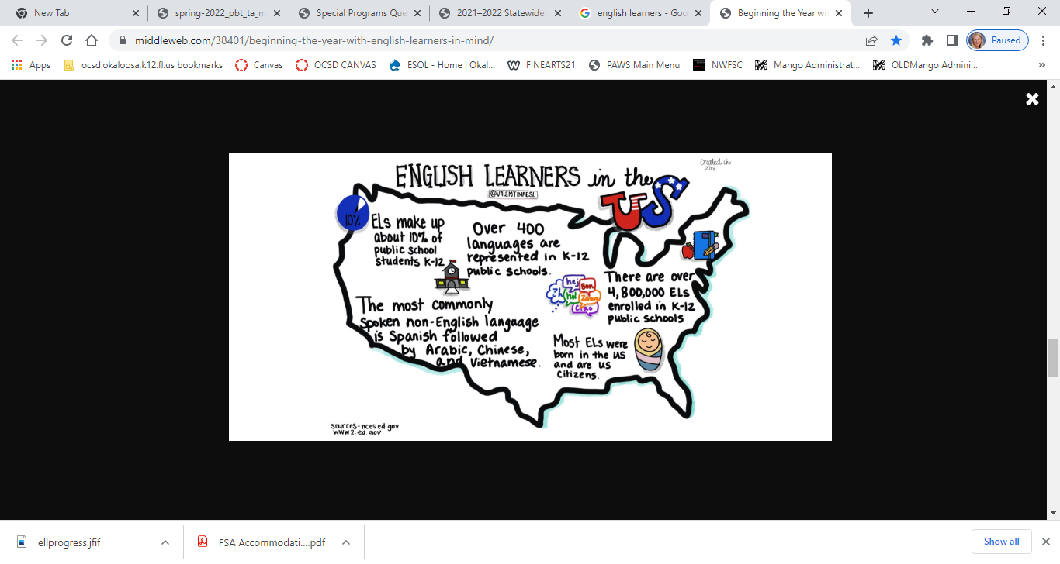

Slide 3


A variety of assessments are available to K-12 educators.
Learning when and why to use assessment tools will make the difference in informing instruction and evaluating student progress.

Slide 4


Types of Assessments Specifically for ELLs
ESOL Entry / Eligibility Test
WIDA Access for ELLs
Based on statutory requirements, at the time of enrollment, the student’s family is required to complete a Home Language Survey. If one or more affirmative answers are provided on the survey, the student will be administered a state-approved eligibility test to measure English proficiency.
OCSD uses the LAS Links English Proficiency Test to determine eligibility for ESOL services.
Based on statutory requirement, all Florida ELLs must take the WIDA Access for ELLs each school year until they are dismissed from the ESOL program.
WIDA measures English proficiency in speaking, listening, reading, and writing.
ELLs in Grades K – 2 may be dismissed from ESOL based on qualifying WIDA scores.
ELLs in Grades 3 – 12 may be dismissed from ESOL based on qualifying FSA and WIDA scores.

Slide 5
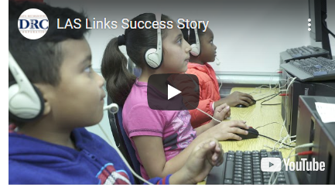
Watch the 5-Minute Video to Learn More about LAS Links

Slide 6
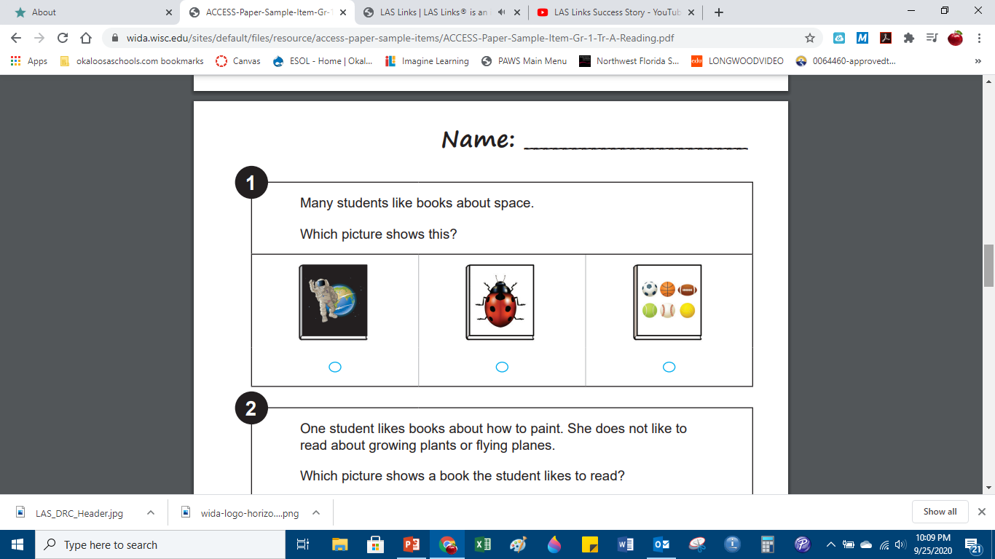
Use the Links Below to Explore the
Sample PRACTICE WIDA Access for ELLs Test Items and Format (choose the grade level(s) you currently serve):
Grade 1 - Speaking
Grade 2 - Reading
Grade 3 - Reading
Grade 4 - Reading
Grade 5 - Writing
Grades 6- 8 - Reading
Grades 9-12 - Writing

Slide 7
Formative Assessment
Formative assessment refers to the ongoing process students and teachers engage in when they…
  focus on learning goals
  take stock of where current work is in relation to the goal
  take action to move closer to the goal
Formative assessment occurs both before and during the learning process.
ACSD – Formative Assessment Strategies, Second Edition, S. Brookhart

Slide 8
Common Examples of Formative Assessment
The following are a few representative examples of formative assessments:
Questions that teachers pose to individual students and groups of students during the learning process to determine a potential struggle with specific concepts or skills.
Specific, detailed, and constructive feedback that teachers provide on student work, such as journal entries, essays, worksheets, research papers, projects, ungraded quizzes, lab results, or works of art, design, and performance. The feedback may be used to revise or improve a work product.
“Exit slips” or “exit tickets” that quickly collect student responses to a teacher’s questions at the end of a lesson or class period. Based on student responses, the teacher can modify the next lesson to address appropriate concepts or provide re-teaching. “Admit slips” are a similar strategy used at the beginning of a class or lesson to determine what students have retained from previous learning experiences.
Self-assessments that allow students to think about their own learning process, to reflect on what they do well or struggle with, and to articulate what they have learned or still need to learn to meet course expectations or learning standards.
Great Schools Partnership – Ed Glossary - 2014

Slide 9
Formative Assessment Adaptations for ELLs
Common adaptations to consider for ELLs on formative assessments may include any of the following:
Providing extended time and/or opportunities to break up longer test content over a period of time can be helpful for ELLs at the beginning stages of English proficiency. However, extended time should never be viewed as the only adaption needed for ELLs.
Reducing linguistic complexity – provide word banks or sentence frames; reduce the number of choices on multiple choice or matching formats; provide basic vocabulary support with content and with test directions
Providing visual support for key terms or concepts
Allowing the student to use translation tools (such as Google Translate or Microsoft Translator) or a content-area glossary to provide home language support
Allowing the student to draw or illustrate a concept if he/she does not yet have the English proficiency to provide a written response

Slide 10
Summative Assessment
Summative assessment occurs at the end of key segments in a learning cycle or the end of the learning process.
The goal of summative assessment is to evaluate student learning at the end of an instructional unit by comparing it against some standard or benchmark.
Summative assessments are given at the conclusion of a specific instructional period, and therefore they are generally evaluative, rather than diagnostic—i.e., they are more appropriately used to determine learning progress and achievement, evaluate the effectiveness of educational programs, measure progress toward improvement goals, or make course-placement decisions, among other possible applications.
ACSD – Formative Assessment Strategies, Second Edition, S. Brookhart

Slide 11
Common Examples of Summative Assessment
Some of the most well-known and widely discussed examples of summative assessments are the standardized tests administered by states and testing organizations, usually in math, reading, writing, and science. Other examples of summative assessments include:
End-of-unit or chapter tests
End-of-term or semester tests
Standardized tests that are used to for the purposes of school accountability, college admissions (e.g., the SAT or ACT), or end-of-course evaluation (e.g., Advanced Placement or International Baccalaureate exams)
Culminating demonstrations of learning or other forms of “performance assessment,” such as portfolios of student work that are collected over time and evaluated by teachers or capstone projects that students work on over extended periods of time and that they present and defend at the conclusion of a school year.
Great Schools Partnership – Ed Glossary - 2014

Slide 12
Florida Standards Assessment
(FSA)
Allowable Accommodations for ELLs

Slide 13
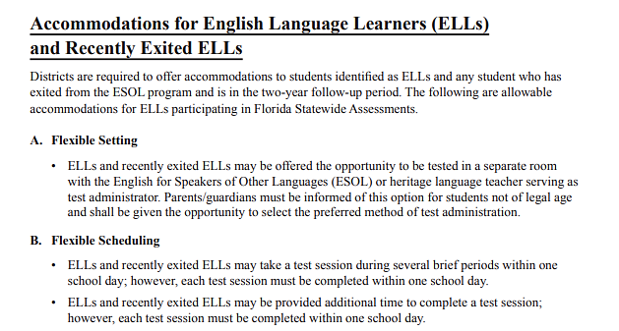
2021-2022 FSA Accommodations for ELLs
(Source: Florida Department of Education FSA Accommodations Guide. Retrieved from excerpt pp. 9-10 – FDOE https://fsassessments.org/-/media/project/client-portals/florida/pdf/manuals-and-user-guides/accommodations-guide.pdf
Continued next slide

Slide 14
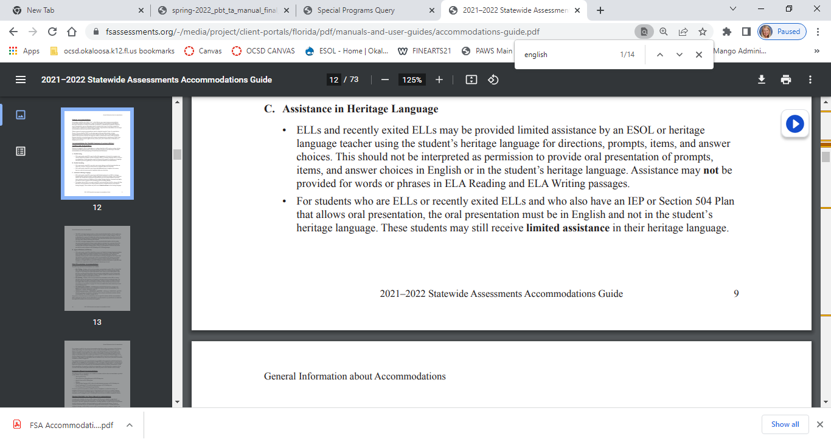
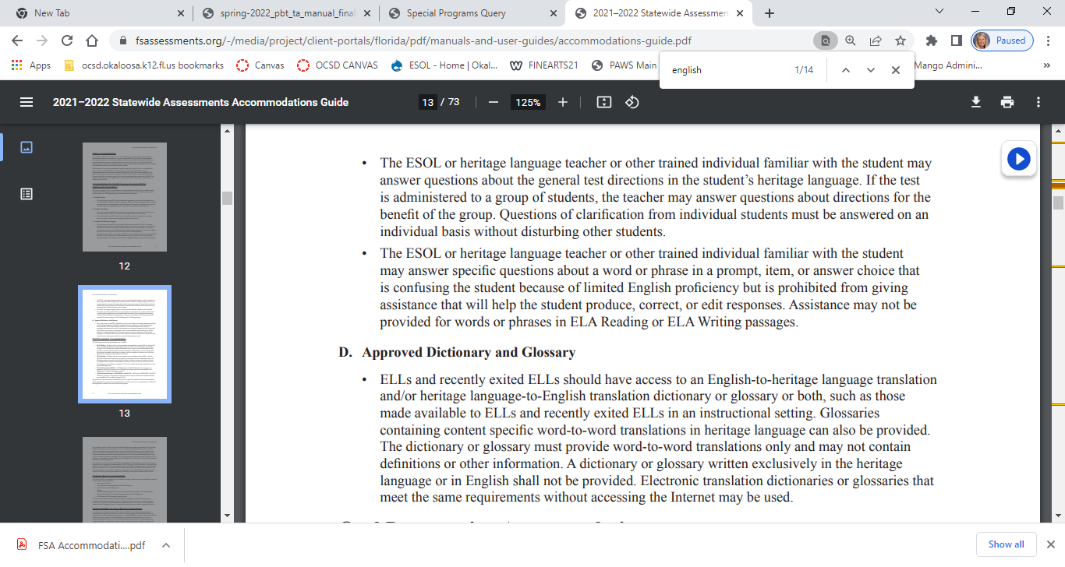
2021-2022 FSA Accommodations for ELLs
(Source: Florida Department of Education FSA Accommodations Guide. Retrieved from excerpt pp. 9-10 – FDOE https://fsassessments.org/-/media/project/client-portals/florida/pdf/manuals-and-user-guides/accommodations-guide.pdf
Continued from previous slide
Continued next slide

Slide 15
2021-2022 FSA Accommodations for ELLs
(Source: Florida Department of Education FSA Accommodations Guide. Retrieved from excerpt pp. 9-10 – FDOE https://fsassessments.org/-/media/project/client-portals/florida/pdf/manuals-and-user-guides/accommodations-guide.pdf
Continued from previous slide

Slide 16
2021-2022 FSA Accommodations for ELLs
Providing full home language translation of an FSA Assessment is not allowed per Florida DOE.
Source: Florida State Board of Education Rule 6A-6.09091 - Accommodations of the Statewide Assessment Program Instruments and Procedures for English Language Learners

Slide 17



Common Goal = Supporting English Learners on the path to language acquisition and content-area achievement.

